Slide 1
#1.1: Command Line and Navigating Files
Slides with “ARQ” are copied or adapted from Aaron R. Quinlan

Slide 2
Access the slides and files here:
https://github.com/j-berg/bioinformatics_bootcamp

Slide 3
Course Overview and Goals
Week 1 & 2:
Using the command line for bioinformatics
Week 3 & 4:
Basics of programming and writing simple tools in Python
Week 5 & 6
Statistics and visualization in R

Slide 4
Course Overview and Goals
Purpose of the course is to introduce you to the language and power of programming
Help you start thinking about how you can use programming and bioinformatics in your research
Determine which language is most applicable to you to start with

Slide 5
Class structure
Mondays/Wednesdays
Conceptual lecture with demonstrations
Fridays
Review session for weeks sessions
Troubleshooting homework problems together

Slide 6
Some words of advice
Just like learning any new language, programming takes time and can be difficult
With more practice, fluency will improve
Don’t be discouraged if you have to Google everything (I still do this daily, even with tasks I’ve done time after time)
Ask your classmates for help on Slack – troubleshoot together
Best way to learn is to break the code, troubleshoot it, find out why it didn’t work, and find out why the solution actually works

Slide 7
Pseudo-code
Using simplified language to plan your program
Helps keep your programming organized
Like outlining an essay before writing to keep it concise, focused, and flowing

Slide 8
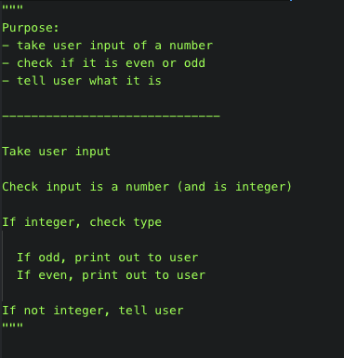
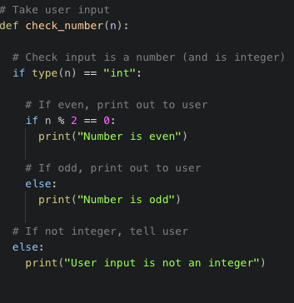
Pseudo-code

Slide 9
Logging onto the supercomputer
Computational biology tasks are resource intensive
Super-computing resources commonly need to be used
Lets you step away while the computer does the hard work
Or else you won’t be able to use your computer for a couple of days

Slide 10
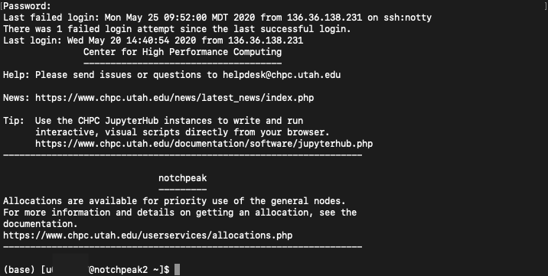
macOS
Open finder
Type “Terminal” and press enter
Type the following:
Verify host key
Password will not show characters while typing
To exit, type “logout”

Slide 11
Windows
Download PuTTY
“Host Name”: notchpeak.chpc.utah.edu
“Connection type”: SSH
Press the ‘Open’ button at the bottom of the dialog box, and PuTTY will begin trying to connect you to the server.
Verify host key
Enter the username and the password, and the server should grant you access and begin your session. If you have mistyped your password, most servers will give you several chances to get it right.
To exit, type “logout”

Slide 12
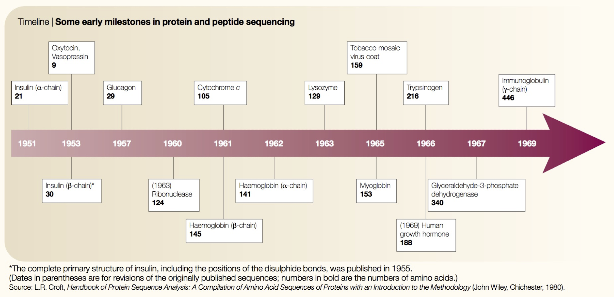
Comp. biology was born in the 1960s
ARQ
Began with amino acid sequencing in 1960’s
Need for computational power to answer questions and study protein biology
Scarcity of academic computers was no longer a major problem
Allows analyses that would take several lifetimes by hand
Joel Hagen, “The origins of bioinformatics”, NRG, Dec. 2000

Slide 13

What is Unix?
ARQ
Definition 1: Your interface with the underbelly of the computer
Definition 2: Where computational genomics is done.
Definition 3: Your dear friend.
Recommended reading: “The Evolution of the Unix Time-sharing system”, Dennis M. Ritchie https://pdfs.semanticscholar.org/f64f/6e66da16e93ebf4221fc8915b2420fd56b66.pdf

Slide 14
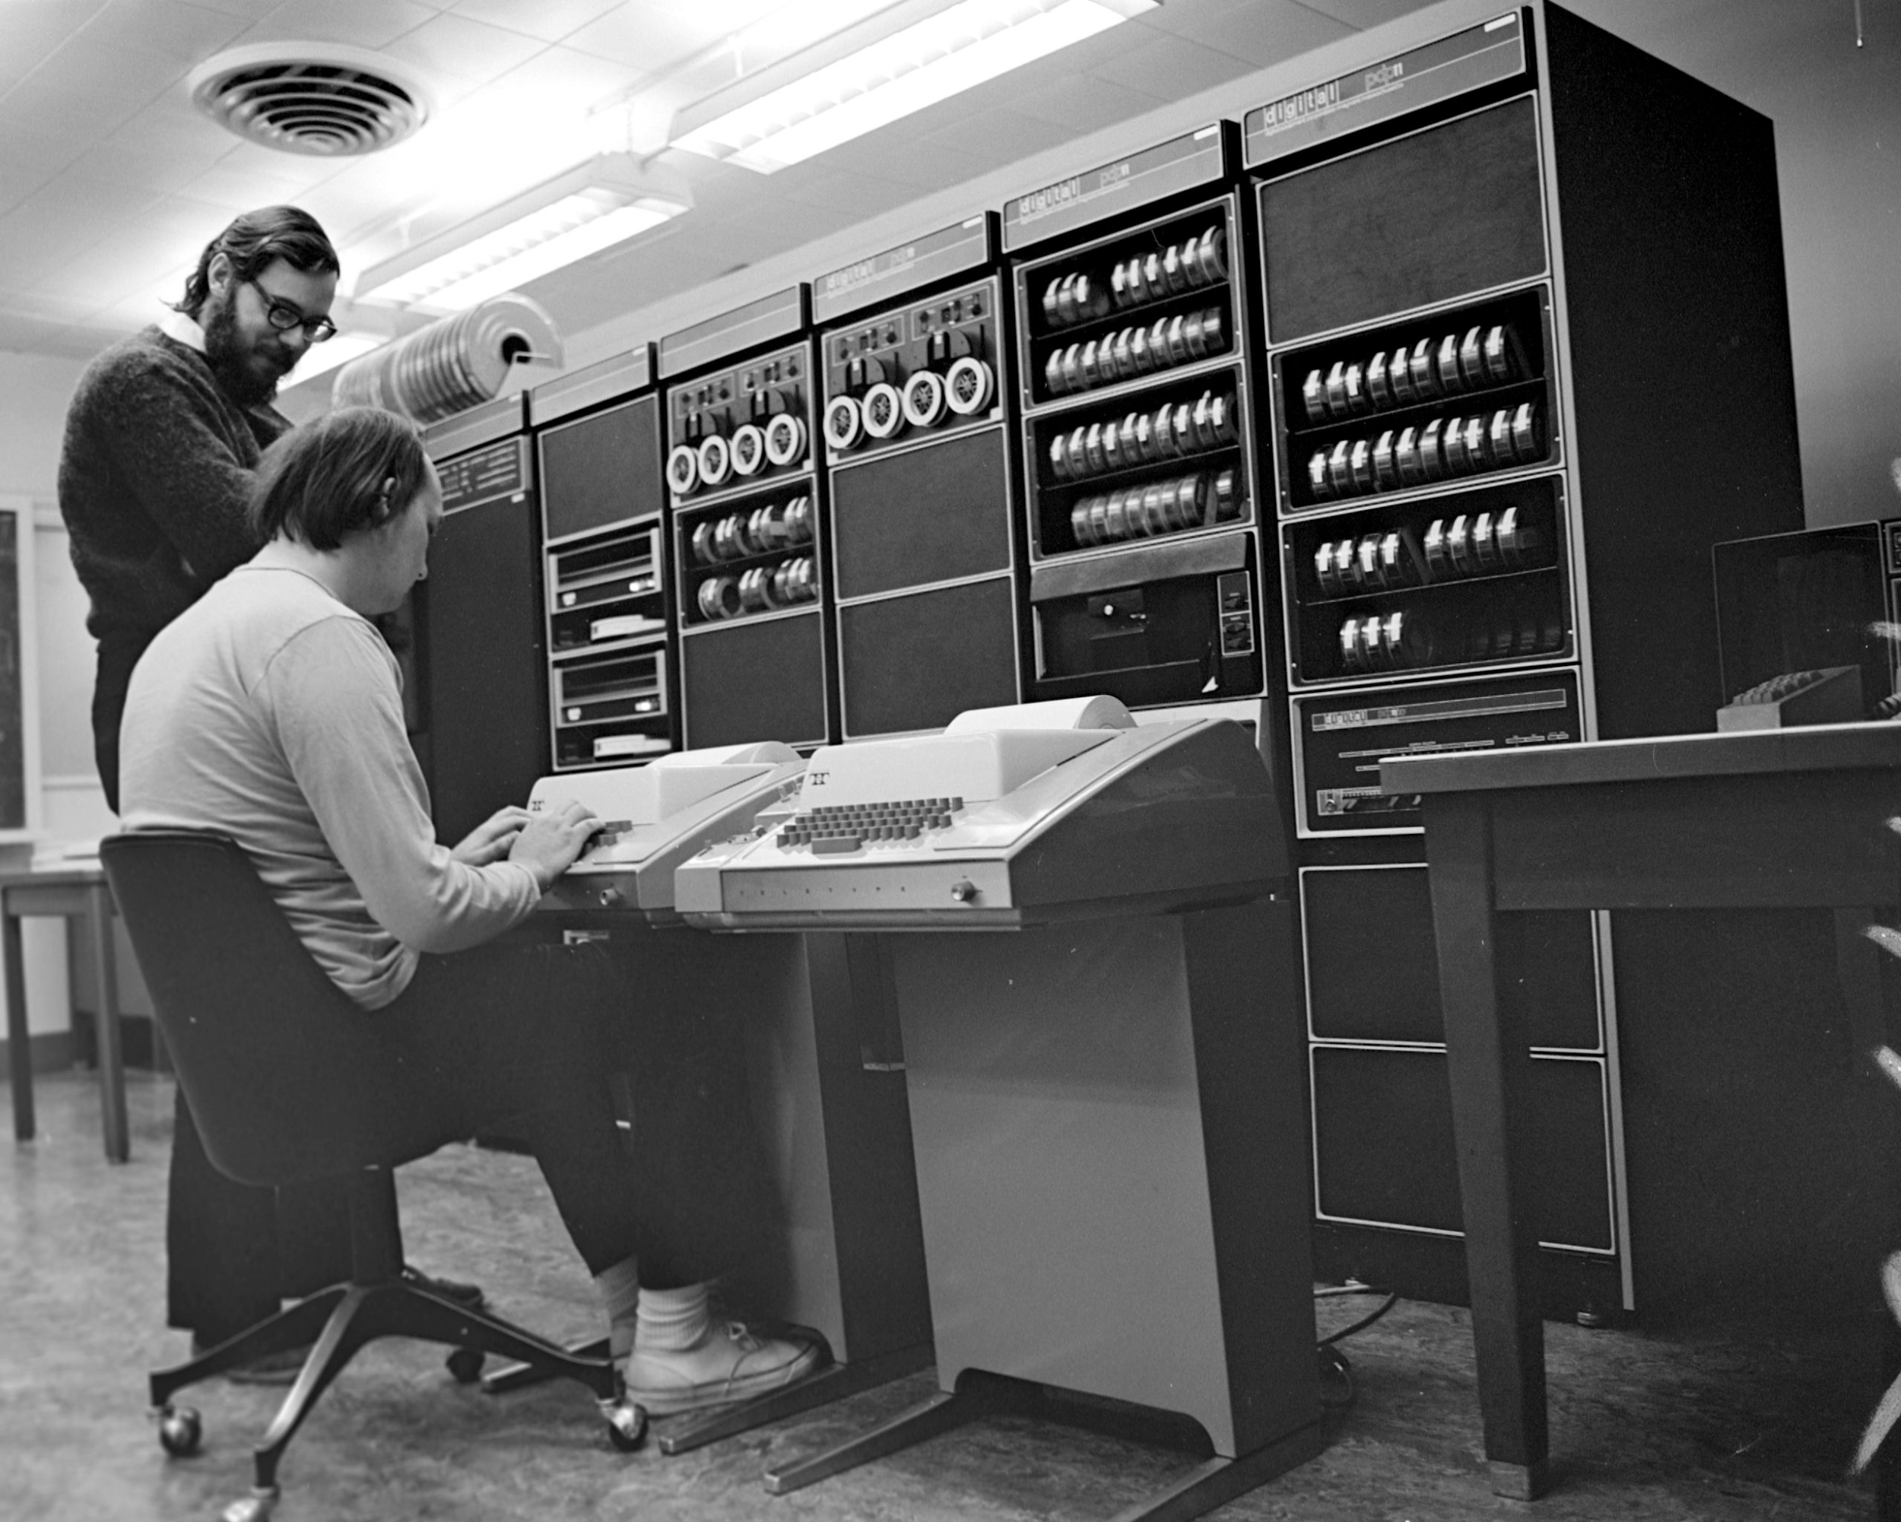
Unix history
ARQ
Ken Thompson (sitting) and Dennis Ritchie working together at a PDP-11
Initial file system, command interpreter (shell), and process management started by Ken Thompson
Vast array of simple, dependable tools that each do one simple task.
By combining these tools, one can conduct rather sophisticated analyses
Wildly popular platform for high performance computing. Supports parallelism.
Most computational biology tools come with a command line interface for using the tool.
Credit:https://en.wikipedia.org/wiki/History_of_Unix

Slide 15
Unix basics
ARQ

Slide 16
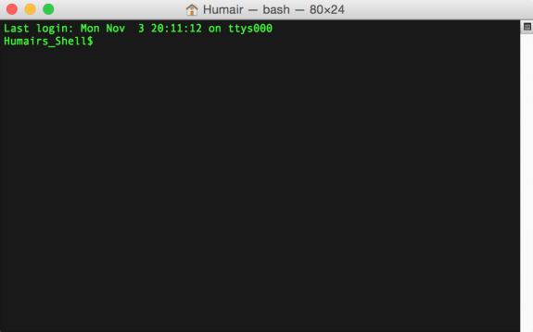
The “prompt”
ARQ
The prompt is just a patient little thing that waits around for you to tell it what to do via “commands”.
Command syntax must be exact. In this way, Unix is dumb. It cannot infer what you meant if you misspell, provide the wrong syntax, etc.

Slide 17
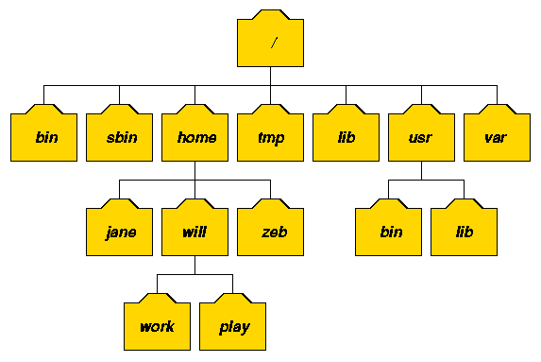
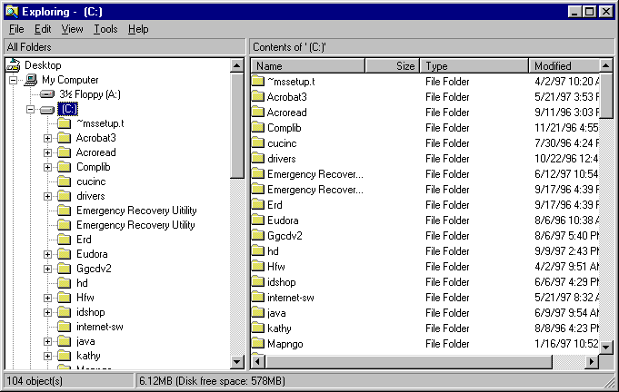
The Unix file system. A tree just like OSX and Windows
ARQ

Slide 18
I am lazy. You should be too. Shortcuts!!!
Go back to past commands with the arrow keys.
The history command will report the commands you have used in the past.
Type the "Ctrl" "r" keys at the same time to bring up a search for commands that contain search terms. Use the arrow keys to cycle through all commands that match the search term.
Use the "Tab" key for autocomplete - just like your smartphone!
Type the "Ctrl" "c" keys at the same time to kill a command.
ARQ

Slide 19
Unix is a stupid robot
Spaces: Spaces in names of files could be interpreted as a new command, use underscores instead!
Case sensitivity: If a command of file name is capitalized, it needs to be typed that way!
Spelling: There is no spell check. If you mis-type a command or file name, it will not find it!
https://en.wikipedia.org/wiki/Bender_(Futurama)#/media/File:Bender_Rodriguez.png

Slide 20
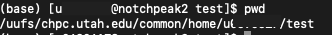
Where am I?
“Print Working Directory”
$ pwd
Will output the absolute pathway to your current working directory
https://www.independent.co.uk/arts-entertainment/books/news/wheres-the-brains-behind-wally-6261459.html

Slide 21
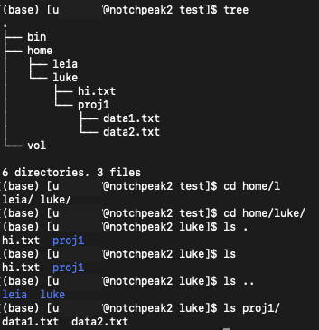
How do I move?
“Change directory”
$ cd
Move your current working directory
We are in the “test” directory
We want to move to the “luke” directory
Only the text after the “$” is the command

Slide 22
What else is around me?
List
$ ls
Lists the files and folders in the specified directory
. => current directory
.. => back one directory
/ => separate folders in a folder pathway

Slide 23
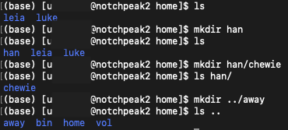
How to I make a new folder?
“Make directory”
$ mkdir
Flexible directioning – can make one in your current directory, in a directory in another folder, or one directory backwards

Slide 24
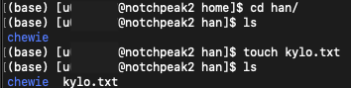
How do I make a new file?
$ touch
Create a new file, plain and simple

Slide 25
How do I add text to a file?
> takes the standard output of the command on the left and redirects it to the file on the right.
>> takes the standard output of the command on the left and appends it to the file on the right.

Slide 26
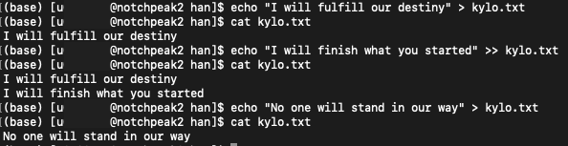
How do I read a file?
“Concatenate”
$ cat
Create one or multiple files, view their contents, redirect file output

Slide 27
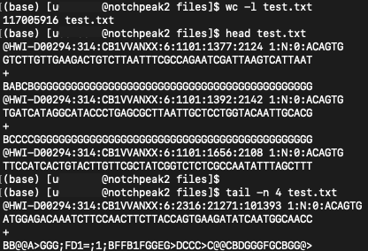
How to I read a sample of a file?
!
$ head
$ head -n 15
$ tail
$ tail -n 5
By default, each will read the first or last 10 lines, but can be modified with the -n argument
1
2
3
4
5
6
7
8
9
10
1
2
3
4

Slide 28
How do I handle reading a large file?
$ less -S filename
Use arrow keys to move up/down left/right

Slide 29
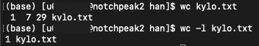
How do I print out metadata about a file?
Word count
$ wc
Print newline (number of lines),
word, and byte counts for each file

Slide 30
Delete a file or folder
BE CAREFUL, ONCE YOU DELETE A FILE OR FOLDER IT’S GONE FOREVER!!!
$ rm filename
$ rm -r directoryname

Slide 31
How do I logout from from the supercomputer?
$ logout
or
$ exit

Slide 32
Review commands
pwd: print current directory
cd: move to a new directory
ls: list files and folders in a directory
mkdir: make a new directory
touch: make a new file
cat: read a file
head: Read the first n lines
tail: Read the last n lines
wc: display the number of lines, words, and characters
less –S: read and scroll through a file
. : current directory
.. : back a directory
> : Write to file
>> : Append to file
CAUTION!:
NO TAKEBACKS!
rm: remove file
rm –r: remove folder

Slide 33
Homework
Run and copy these commands and outputs to a file
Log into the supercomputer
Print your current working directory to the console
Make a folder called “class_1”
Navigate into this new folder
Make a new file called “test.txt” within the folder
Append “Hello World” to the file
Print out the number of lines in the file
Navigate back to your home directory
Logout

